Slide 1
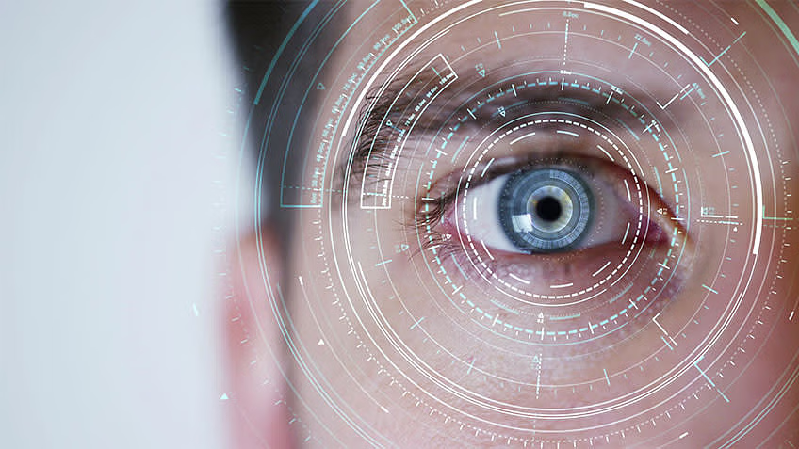
MATHEMATICS FOR COMPUTING – 2
Fourier Transformation in Image Processing
TEAM 16
KISHORE B - CB.SC.U4AIE23139
SAI CHARAN M - CB.SC.U4AIE23143
M KOUSHAL REDDY - CB.SC.U4AIE23145
NAVEEN BABU M S - CB.SC.U4AIE23153

Slide 2
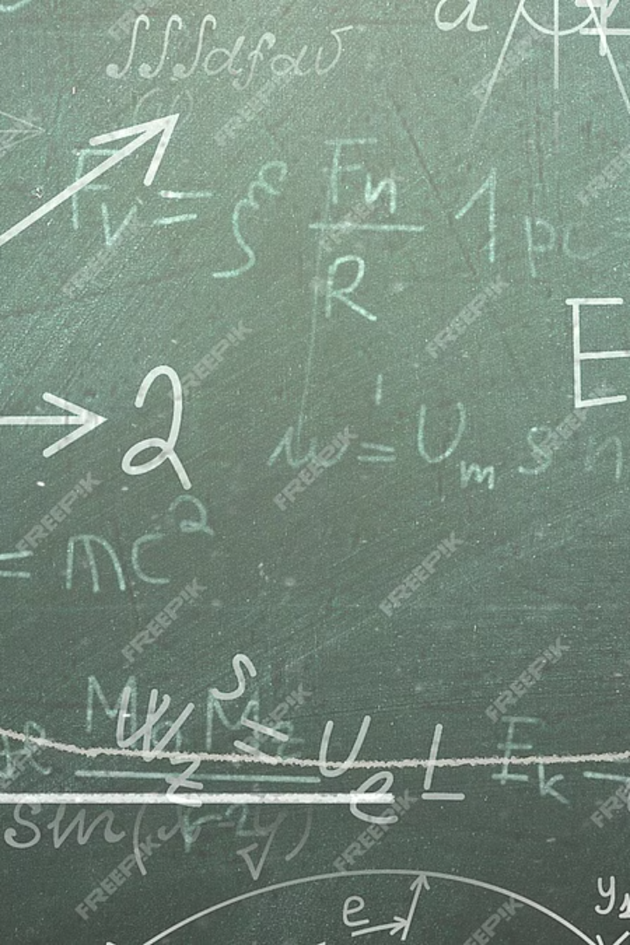
Introduction to Fourier Transformation
Fourier Transformation is a powerful mathematical technique that allows us to analyze and manipulate signals and images in the frequency domain. It decomposes a complex waveform or function into a series of simple sine and cosine waves, each with its own amplitude, frequency, and phase. This transformation has numerous applications in various fields, including signal processing, communications, and image enhancement.

Slide 3
Applications of Fourier Transform in Image Enhancement
Enhancement
Sharpening
Compression
By converting an image from its spatial domain to the frequency domain, the Fourier Transform reveals the underlying frequency content, allowing for targeted enhancements such as sharpening edges, reducing noise, and improving overall image quality.
By selectively amplifying high-frequency components in the Fourier domain, Fourier Transform can be used to sharpen and enhance the edges and details in an image, making it appear more crisp and defined.
Fourier Transform is a key component in image compression algorithms, such as JPEG, which take advantage of the fact that high-frequency components often contain less important information and can be safely discarded to reduce file size.

Slide 4
Dataset
The dataset includes a wide range of image subjects, from natural landscapes and cityscapes to portraits and abstract art, allowing for a comprehensive exploration of Fourier Transform techniques.
The process is done with help of blogs and YouTube videos made by universities and creators and from the official MATLAB site.
For further clarification and understanding LLMs i.e., GPT 3.5 & Gemini are used.
Access to source:
https://uk.mathworks.com/help/images/fourier-transform.html
https://vincmazet.github.io/bip/filtering/fourier.html
https://www.sci.utah.edu/~gerig/CS6640-F2014/Materials/CS6640_F2014_Fourier_I.pdf
https://www.cs.unm.edu/~brayer/vision/fourier.html
https://www.youtube.com/watch?v=spUNpyF58BY&ab_channel=3Blue1Brown

Slide 5
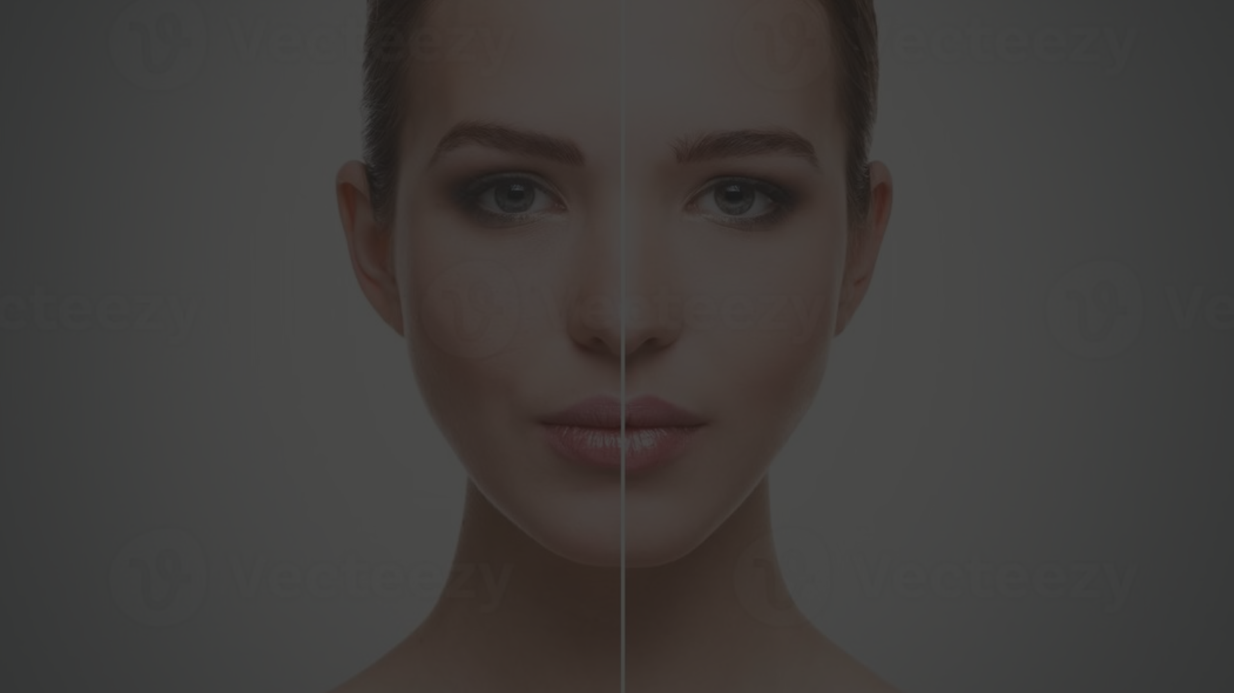
Image Enhancement and Restoration
Fourier Transform
1
The Fourier Transform is applied to the input image, converting it from the spatial domain to the frequency domain. This allows us to identify and manipulate the different frequency components that make up the image.
2
Frequency Filtering
Based on the analysis of the Fourier Transform, specific frequency components can be selectively amplified or attenuated to enhance desired features and reduce unwanted artifacts, such as noise or blur.
Inverse Transformation
3
After the frequency-domain processing is complete, the modified Fourier Transform is then subjected to an Inverse Fourier Transform, converting the image back to the spatial domain and producing the enhanced or restored output.

Slide 6
Output
Improved Image Quality
Preservation of Important Features
The Fourier Transform-based image enhancement and restoration techniques have resulted in significantly improved image quality, with sharper details, reduced noise, and enhanced visual clarity.
The selective frequency filtering approach has ensured that the essential features and characteristics of the original images are preserved, while unwanted artifacts and distortions are effectively removed.
Enhanced Frequency components
Increased Efficiency
After applying enhancement techniques in the frequency domain, the output includes enhance frequency components. Enhanced high-frequency components can improve edge sharpness, detail visibility, and overall image quality.
The computational efficiency of the Fourier Transform-based techniques has enabled faster and more streamlined image processing workflows, contributing to enhanced productivity and time-saving benefits.

Slide 7
Contribution
Kishore -
Research on the overall process of Fourier Transform and provided idea of enhancement and magnitude spectrum in MATLAB.
Sai Charan -
Research on Enhancement using Fourier Transform in Image Processing and spectral analysis
Koushal -
Research on adaptive filtering and to supress noise and preserving image details in frequency domain.
Naveen -
Research on overall process of Fourier Transform and enhancement and frequency analysis in Fourier Transform and Inverse Transform.

